Slide 1
TechExcel: Integrating Azure PaaS and AI Services for AI Design Wins

Slide 2
Lab Overview

Slide 3




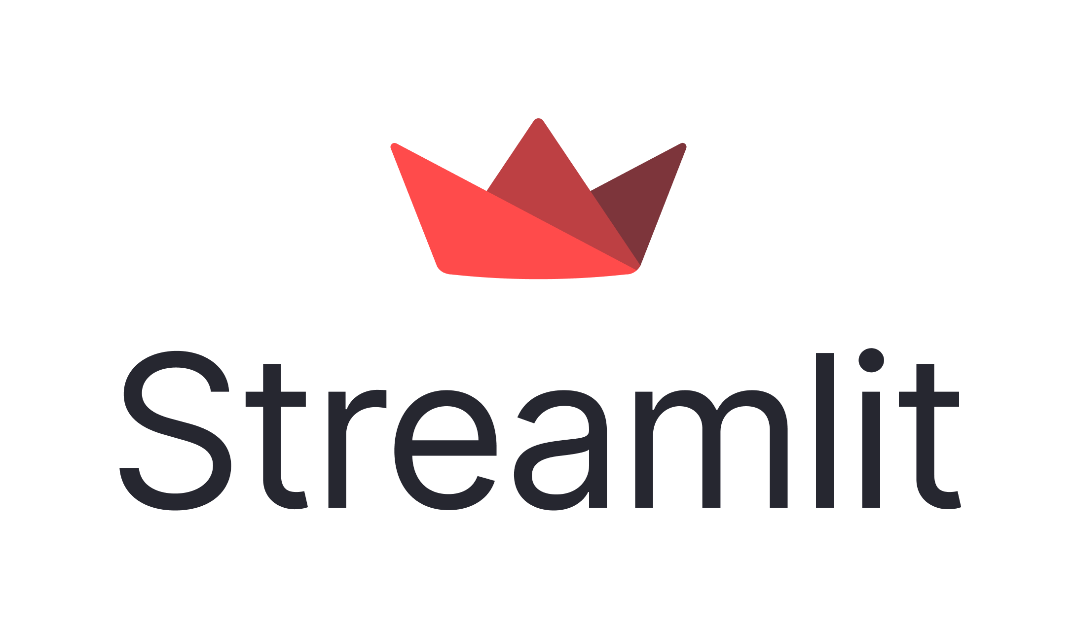

Initial Application
Contoso Suites Application
SQL DB
Cosmos DB
Function App
(Not running)
Web API (C#)
Azure OpenAI
Notes:
Speaker notes:
Contoso Suites has provided us a starting code base. It centers around two applications: a C#-based web API and a Python-based Streamlit dashboard app. This application represents a slimmed-down variant of their Customer Information System (CIS) suite, and they would like us to use this code base for our proof-of-concept work.
The center point of this solution is their Web API, a .NET 8 web application. This application interfaces with two databases: an Azure SQL Database that includes bookings information and a Cosmos DB container for property maintenance requests. The Web API serves a series of endpoints for front-end applications, in this case a Streamlit dashboard application.
The Streamlit app makes HTTP-based REST API calls to the Web API service, retrieving and displaying data on the page. Contoso Suites developers have also performed some basic testing of Azure OpenAI and have put together a simple integration with a GPT-4o deployment for the purpose of chat completions.
There is also the code for a C#-based function app intended to generate text embeddings via vectorization. This function app is available but has not been deployed or used.

Slide 4
Web API Structure
Project name: ContosoSuitesWebAPI
Program.cs
Starting point for the web service
AppConfig.cs
Simple application configuration class for connection to Azure OpenAI
Agents\ and Plugins\
Folders containing Contoso Suites’ attempt at building a copilot for property maintenance. Work in progress you will complete.
Entities\
POCOs (Plain Old Class Objects) representing key elements of the Customer Information System: Hotel, Customer, Booking, HotelRoom, BookingHotelRoom, MaintenanceRequest
Also contains a POCO for vector search results (functionality you will implement)
Services\
Contains interface and implementation details for connections to Azure SQL DB and Cosmos DB
IDatabaseService + DatabaseService → Azure SQL Database
IVectorizationService + VectorizationService → Cosmos DB
Notes:
Speaker notes:
The Web API project is located in a folder entitled ContosoSuitesWebAPI. The starting point for this project is Program.cs, which builds out the web application and determines which endpoints we want to expose. There is also a simple configuration class called AppConfig.cs that you will use in Exercise 2 to validate that you have appropriate connection details for Azure OpenAI.
The Agents\ and Plugins\ folders contain Contoso Suites’ attempt at building a copilot for property maintenance. They have put together part of the solution but were not able to get everything figured out. You will complete this task in Exercise 5.
Inside the Entities\ folder, you can find a series of classes representing key elements of the Customer Information System. Contoso Suites owns a set of hotels in various cities and countries. Customers are individuals who stay at those hotels. Customers make bookings to indicate that they would like to stay at a particular hotel over some time frame. Each hotel contains some number of hotel rooms, and we also keep track of which hotel rooms we associate with a given booking. The current CIS assigns hotel rooms the day before the reservation period, so not all bookings have hotel rooms yet. Finally, maintenance requests may come from guests staying at the hotel, hotel staff, or inspectors. Maintenance requests indicate issues that the maintenance staff may need to remediate.
The Services\ folder includes two interfaces: IDatabaseService and IVectorizationService. These two interfaces cover the available methods for connection to Azure SQL Database and Cosmos DB, respectively. Each interface also has an implementation in DatabaseService and VectorizationService. The DatabaseService class is a simple class designed to enable querying against bookings data in Azure SQL Database. You will create the relevant database tables and load data during Exercise 2. The VectorizationService will allow users to translate a string or text document into an embedding, and perform semantic search against property maintenance records using these embeddings. You will implement this in Exercise 3.

Slide 5
Dashboard Structure
Index.py
.streamlit\
Secrets.template.toml
pages\
1_Chat_with_Data.py
2_API_Integration.py
3_Vector_Search.py
4_Call_Center.py
5_Call_Center_Search.py
6_Copilot_Chat.py
Notes:
Speaker notes:
The launch page for the Contoso Suites dashboard application is Index.py. This is a simple landing page whose primary purpose is to navigate users to the appropriate page. For the purpose of this proof of concept, Contoso Suites wants to keep different requests in separate files, so they do not need to deal with an overly complex code base.
The .streamlit folder contains secrets and configuration information in TOML (Tom’s Obvious Minimal Language) format. We have provided you with a template file, containing all of the secrets that you will need for these exercises, and the exercises will give you information on what to fill in for each. These secrets are how we will connect to each of the Azure services, as well as the Web API endpoint.
The pages\ folder is a Streamlit convention. By default, any Python scripts inside of here will show up as individual pages on the application’s sidebar, in lexicographical order. Another Streamlit convention is that leading numbers do not show up, but do affect ordering. Additionally, Streamlit replaces underscores with spaces when displaying page names. Therefore, although the first file’s name is 1_Chat_with_Data.py, it will show up as the first item in the sidebar with a label of “Chat with Data.”
The Chat with Data page represents Contoso Suites’ basic attempt at interacting with Azure OpenAI. They have created a simple page that allows for chat operations, but they do not know how to integrate their own data to ground discussions. They have provided most of the plumbing code, allowing you to implement the RAG pattern using Azure AI Search in Exercise 1.
The API Integration page includes three HTTP requests against the Web API service and requires a Streamlit secret containing the Web API URL. When you provide the URL as a secret, the page will work as-is and display some information on hotels. Contoso Suites would like to extend this page to enable their support personnel to use natural language to query bookings information. This is a key part of Exercise 2.
The Vector Search page covers Exercise 3’s contents. It includes functions that call the Web API’s vectorization endpoints that you will implement. As part of this exercise, you will complete the page, letting support personnel perform semantic search against the property maintenance data set in Cosmos DB.
Exercise 4 requires two pages: Call Center and Call Center Search. The Call Center page serves to show off several capabilities in Azure OpenAI and Azure AI Services, including speech-to-text transcription, checking a call for compliance with specific policies, performing abstractive and extractive summarization with Azure AI Services, performing summarization with Azure OpenAI, and performing sentiment analysis and opinion mining with the Azure AI Services Language service. Then, you will generate embeddings of the abstractive summary and save this embedding vector, along with the call transcript and abstractive summary, to a Cosmos DB container. The Call Center Search page will enable support personnel to perform semantic search operations against call summaries, bringing back the most relevant results.
The final page, Copilot Chat, covers Exercise 5. This page serves as the front end for the maintenance copilot that you will build in the Web API.

Slide 6
Miscellaneous Resources
ContosoSuitesVectorizationFunction\
InfrastructureAsCode\
.github\workflows\
data\
audio\
Notes:
Speaker notes:
In addition to the two main projects, there are assets available in several other folders.
The ContosoSuitesVectorizationFunction folder contains the makings of an Azure Function app that reads a Cosmos DB change feed for new records, generates an embedding vector based on the text contents of a maintenance request, and saves the embedding with the rest of the maintenance request document. The operating code for this is in the Run() method inside the CosmosChangeFeedVectorization.cs file, and you will use this in Exercise 3 to automate vectorization of records in Cosmos DB.
All of the Azure services you will use in this training are available in a Bicep script inside the InfrastructureAsCode\ folder. You will deploy these assets into a resource group that you create as part of Exercise 1. Once the training is over, you can delete the resource group.
You will use GitHub Actions workflows to deploy the Web API and Dashboard applications to Azure Application Services as a key part of finishing several of the Exercises. We have provided nearly-complete workflows for these, entitled api.yml and dashboard.yml. Exercise 1 will cover instructions on what you need to change for your specific environment before you can deploy these workflow files.
There are several sample data files that Contoso Suites has provided. All of these are in the data\ folder. These files are in a variety of formats: some are in JSON file format, others are plain text files, and they have also provided a SQL script to populate bookings history into Azure SQL Database. Additionally, to make testing semantic search operations easier, you will find an example of a vectorized query in Query_Vector.txt. Finally, the audio\ folder contains one sample customer call that Contoso Suites would like to use for call center operations in Exercise 4.

Slide 7
Deploy application resources
Exercise 1

Slide 8








Exercise 1 Architecture
Contoso Suites Environment
Resource Group
Local Machine
SQL DB
Storage Account
Cosmos DB
Visual Studio Code
Python
Azure AI
Language
App Service
Plan +Services
AI Search
Azure OpenAI
Git
Function App
AI Speech
Container
Registry
Notes:
Exercise 1 will focus on preparing two separate environments: an Azure resource group containing necessary services, and a local machine with the development resources needed for this training.
You will be given a Bicep script in task 1 that builds out a series of Azure resources that you will need for the training.
In the meantime, task 2 covers the installation of local tools. We recommend having Visual Studio Code and some installation of Python installed. You can get by with a standard version of Python 3.10 or later.

Slide 9
Introduction: Deploy app resources
In this lab, you’ll set up a development environment in Azure and on your local machine. From there, you will index data in a vector store and write code to chat with your data. You will also deploy a Web API and dashboard to Azure Application Services.
After completing this lab, you’ll be able to:
Deploy a Bicep script to build Azure resources
Load data into Azure AI Search and query it from code
Deploy applications to Azure Application Services
Notes:
Speaker notes:
In this exercise, you will lay the groundwork for Azure OpenAI integration by deploying out a series of Azure resources and ensuring your local machine has the appropriate software installed.
Learning objectives
After completing this lab, you'll be able to:
Deploy a Bicep script to build Azure resources
Load data into Azure AI Search and query it from code
Deploy applications to Azure Application Services

Slide 10
A Brief Introduction to Azure OpenAI
REST API access to OpenAI language models
Handles a variety of natural language-based tasks
Users access via REST API, Python SDK, or web-based interface in Azure OpenAI Studio
Works through prompts and completions
Prompt: Text input sent to a model deployment
Completion: resulting output from the model deployment
Notes:
Speaker notes:
Azure OpenAI Service provides REST API access to OpenAI's powerful language models, including the GPT-4, GPT-4 Turbo with Vision, GPT-4o, GPT-3.5-Turbo, and Embeddings model series. These models can handle tasks such as content generation, summarization, image understanding, semantic search, and natural language to code translation. Users can access the service through REST APIs, Python SDK, or a web-based interface in the Azure OpenAI Studio.
Regardless of the specific model you choose, there is a common pattern for Azure OpenAI interaction. You create a prompt, which is a text input. The model deployment to which you send this text will interpret the text and perform some action. The output of that action is also known as a completion. Sometimes, the prompt may also include an audio or image input.
We will build a variety of prompts throughout this training and see some of the various results we can get via chat completions.

Slide 11
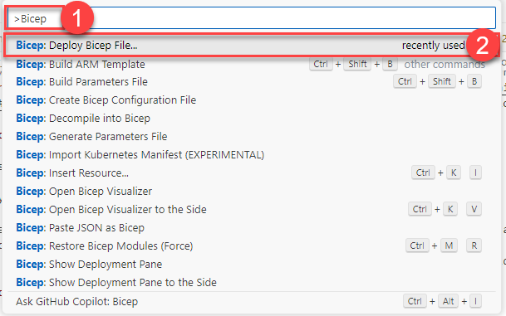
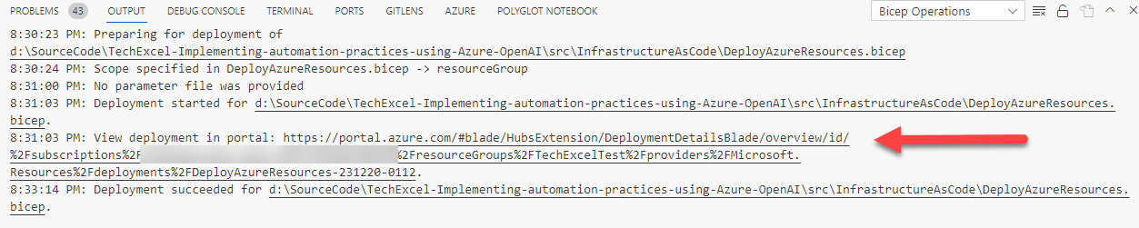
Deploy a Bicep script
Notes:
Speaker notes:
In the first task of this exercise, you will deploy a set of resources to Azure using a Bicep script. One easy way of running a Bicep script is to use the Bicep extension in Visual Studio Code. From there, you can open a Bicep script (file in .bicep format) and deploy it using the Bicep: Deploy Bicep File… command in VS Code. It will ask you for a few pieces of information, such as the deployment name, subscription, resource, group, and parameter file. Then, it will submit the script to Azure and provide you a link to monitor the results of the deployment.

Slide 12
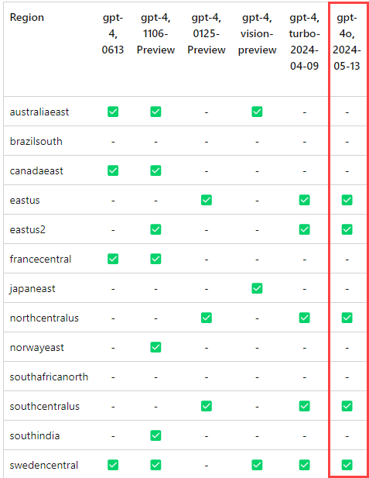
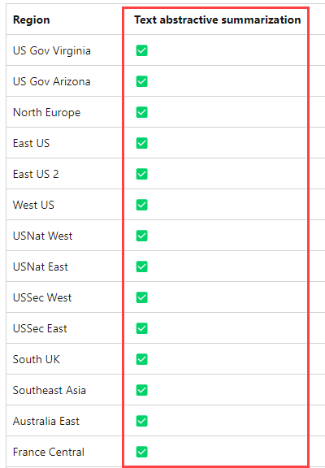
Choose an appropriate region
Notes:
Speaker notes:
You will work with the GPT-4o model in this training. This will limit the number of regions you can use for deployment. Review the region availability table (https://learn.microsoft.com/azure/ai-services/openai/concepts/models#model-summary-table-and-region-availability) and ensure that you choose a region that supports GPT-4o. In addition, you will work with abstractive summarization in the Azure AI Services Language service, and it is only available in certain regions (https://learn.microsoft.com/azure/ai-services/language-service/summarization/region-support).
Be sure to choose a region in common between both of these lists! If not, you may need to deploy additional resources in another region

Slide 13
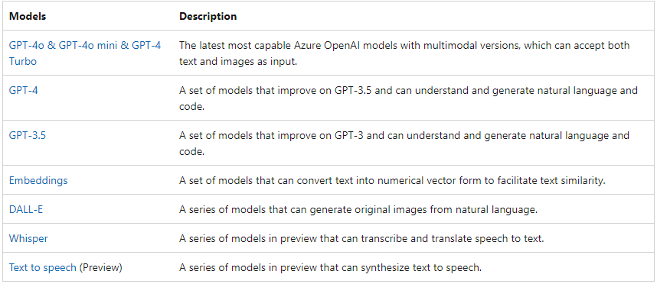
Azure OpenAI Service Models
Azure OpenAI contains several models with different capabilities and price points.
The primary models include:
Notes:
Speaker notes:
There are several service models that make up the Azure OpenAI offering. The two workhorse models are GPT-4o and GPT-4. These models both understand and generate natural language and code. GPT-4 is the most recent generation of the GPT series and has 1.76 trillion parameters versus GPT-3.5's approximately 375 billion parameters. GPT-4o is a newer but smaller model that has several benefits in terms of lower price point than GPT-4 and ability to accept images as prompt inputs. GPT-4 and GPT-4o are not available in all regions, so please make sure to deploy your Azure OpenAI service into a region supporting GPT-4o for the exercises. We do not recommend using GPT-3.5 models in this training because not all tasks are guaranteed to work.
Azure OpenAI contains a few embedding models, and the one we will use is text-embedding-ada-002. There isa new embedding model, text-embedding-3, which generates entirely separate embeddings from text-embedding-ada-002.
There are three other service models. DALL-E allows us to generate images from text prompts. There are also services that perform speech to text and text to speech.

Slide 14

Exercise 1 Task 2 Architecture
Storage Account
Resorts.txt
AI Search
Hotels.txt
FAQ.txt
Azure OpenAI
Notes:
This lab will focus around resort and hotel information. Task 2 of exercise 1 involves uploading customer data into a storage account and process it using Azure AI Search. From there, you will be able to ask questions of the data in the Azure OpenAI Studio Chat Playground, as well as through the Azure OpenAI API in a Streamlit application.

Slide 15
Add Your Data
Supported data sources
Azure Blob Storage
Local file upload (into Azure Blob Storage)
Azure AI Search indexes
Azure Cosmos DB for MongoDB vCore
Azure Cosmos DB NoSQL API
Supported data types
Delimited text (.txt)
Markdown
HTML
Word
PowerPoint
PDF
Notes:
Speaker notes:
Azure OpenAI allows us to ingest data from several data sources. The key supported data source is data in Azure Blob Storage accounts. We can also upload files into a blob storage account for subsequent processing. This processing builds an index in Azure AI Search over your uploaded data, and that allows your GPT-3.5 or GPT-4 model deployment to provide responses based on your data.
This functionality will work for a specific set of data types, including delimited text files, Markdown, HTML files, Word documents, PowerPoint decks, and PDFs. Other data sources, such as hosting data in Azure SQL Database, is not supported at this time.

Slide 16
Streamlit
Python library
Intended for data scientists to build simple applications
Includes a variety of extensions and add-ons
Includes UI components for chat completions
Notes:
Speaker notes:
The client application we will use in this training is built on Streamlit, a Python library intended to make building data applications simple. You can build a functional Streamlit application in a few dozen lines of code, and there are even UI components to make chat completions easy.
Our goal in this training is to minimize the amount of time you spend fiddling with UI components, focusing instead on how we can integrate an existing application with Azure OpenAI.
Streamlit is certainly not the only way to access Azure OpenAI. You can write your own applications in a variety of programming languages, including but certainly not limited to C#, F#, JavaScript, Python, and Java. Several of these languages have full OpenAI or Azure OpenAI SDKs, whereas others will require you to make REST API calls.

Slide 17
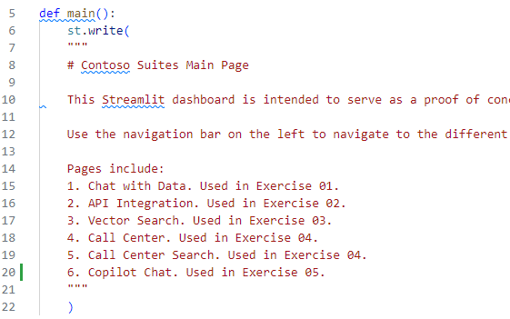
A Brief Overview of Streamlit Architecture
Code in the \src\ContosoSuitesDashboard\ folder
Index.py
pages\
1_Chat_with_Data.py
2_Call_Center.py
…
Index.py
Includes main() function
Notes:
Speaker notes:
All of the client code is in the source directory of the GitHub repository, located in a ContosoSuitesDashboard folder. Inside this folder is a file, index.py. This is the starting point for our Streamlit app. In addition, we have a folder called pages\, inside of which are several additional files that we will use across each of the exercises.
Inside the index.py file, we have a main() function that drives our application. We also have a write() function that writes text out to the screen.

Slide 18
Key Streamlit and Python Tips
Streamlit is a web service
Update process: save and refresh page
Whitespace matters!
Ensure spaces, not tabs
Keep consistent space numbers (typically 4 per level)
Notes:
Speaker notes:
Before we move into the exercise, here are a few tips to make the process of working with Streamlit easier for you. First, keep in mind that Streamlit is a web service and Python does not require code be compiled before execution. This means that, when you change a Python file, you can save the file changes and refresh the page. You do not need to stop and restart the Streamlit service.
For any Python code you write, remember that whitespace does matter. Tabs and spaces are not the same thing in Python, and we highly encourage you to use spaces instead of tabs to prevent any oddities. Also, make sure that your code is aligned correctly. The general practice is to use 4 spaces per "level" of code. By following this practice, you will be able to avoid Python errors around invalid whitespace.
It may also be useful to write the code in an editor like Visual Studio Code, which includes support for formatter extensions (https://code.visualstudio.com/docs/python/editing#_formatting).

Slide 19
Implement function calling
Exercise 2

Slide 20
Introduction: Implement function calling
In this lab, you’ll load data into Azure SQL Database and access it from a Web API. Then, you will use Semantic Kernel to create a function that access bookings information based on natural language inputs.
After completing this lab, you’ll be able to:
Load hotel bookings data into Azure SQL Database
Implement Web API endpoints to retrieve and return bookings data
Create a Semantic Kernel plugin to translate natural language requests into bookings data results
Incorporate API results into the Streamlit application
Notes:
Speaker notes:
Bringing our own data is one great way to enhance GPT models in Azure OpenAI, allowing them to answer questions specific to our circumstances. Another way to customize responses and enhance system capabilities involves function calling, something we can implement using the Semantic Kernel library. In this exercise, you will create a solution allowing end users to query data from Azure SQL Database using natural language.
Learning objectives
After completing this lab, you'll be able to:
Implement hotel bookings history endpoints against Azure SQL Database using C#
Create Semantic Kernel plugins to enable translation of natural language into SQL queries
Incorporate API results into the Streamlit application

Slide 21
Exercise 2 Architecture
Azure OpenAI
SQL DB
Function definitions
Web API (C#)
Notes:
This exercise will focus on incorporating function definitions and executing function calls with a GPT-4o deployment as the intermediary, using Semantic Kernel. You will extend a .NET Web API by creating additional endpoints that query bookings history in SQL Server. You will then use the Semantic Kernel library to accept natural language input and translate it into relevant C# method executions.
From there, you can implement a front end using Streamlit.

Slide 22
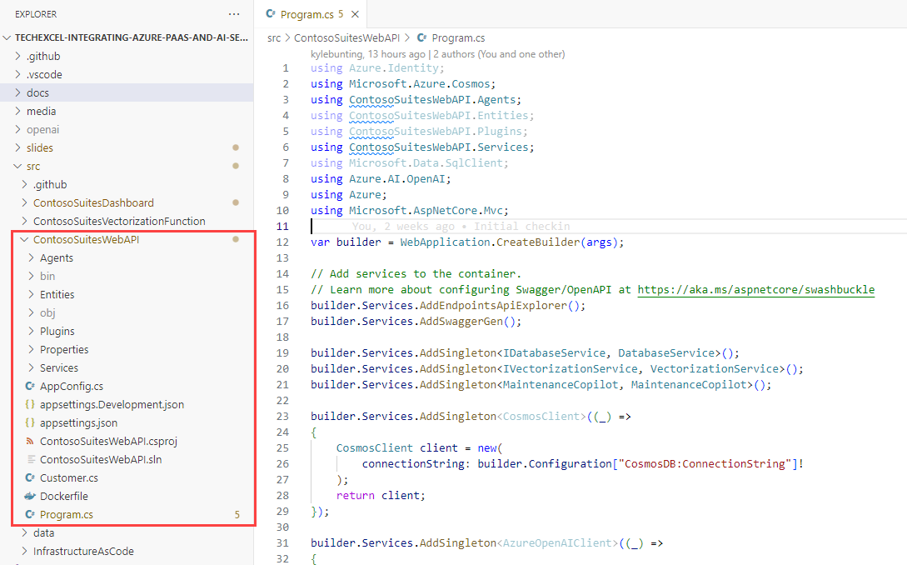
Web API Project
Notes:
Speaker notes:
The Web API project we will use is in the src/ContosoSuitesWebAPI folder. Most of the code is there for your use, but in the exercises, you will complete certain functionality and extend it to support Semantic Kernel.

Slide 23
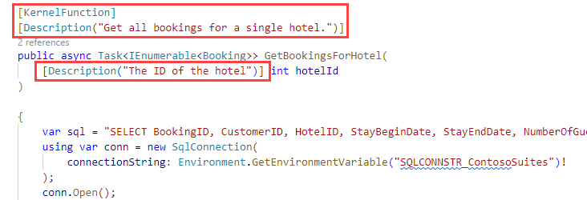
Semantic Kernel
Notes:
Speaker notes:
The way we will interact with Semantic Kernel in this exercise is via the [KernelFunction] decorator. These will tell Semantic Kernel information about methods or functions we’d like to make available via chat completion. All of the code executes -locally--that is, we are not sending data to a remote server hosting our GPT-4o deployment, nor are we allowing the remote server access into our environment to execute code. Instead, Semantic Kernel takes the output from the GPT-4o deployment and uses that output to know which kernel function to call from the local server.

Slide 24
Semantic Kernel: A Warning
Library is rapidly changing
Older examples will not work
We need to use version 1.18 or later
Notes:
Speaker notes:
Before we move into the exercise, it is worth noting that the Semantic Kernel library changes rapidly, and some of these changes break backwards compatibility. For that reason, older examples of how Semantic Kernel works (especially those prior to December of 2023) will not be helpful anymore, as the API has changed so significantly since then.
Furthermore, we will need to use version 1.18 or later of Semantic Kernel because we have a dependency on the Azure.AI.OpenAI 2.0 package. Prior versions of Semantic Kernel, including 1.17, use Azure.AI.OpenAI version 1, and that will cause conflicts.

Slide 25
Implement contextual grounding
Exercise 3

Slide 26
Introduction: Implement function calling against external APIs
In this lab, you’ll create a Web API endpoint for customer data. Then, you will build a function definition for the Azure OpenAI service and write Python code in Streamlit to tie everything together.
After completing this lab, you’ll be able to:
Enable the Vector Search feature in Azure Cosmos DB for NoSQL
Define container vector policies and specify indexing policies
Generate vector embeddings in Cosmos DB and perform similarity searching
Notes:
Speaker notes:
Vector search provides a powerful technique for efficiently finding information within blocks of text. Using Azure Cosmos DB, vector embeddings generated using Azure OpenAI can be stored alongside data. In this exercise, you will add vector search capabilities to Azure Cosmos DB for NoSQL and perform similarity searches using the vectorized data.
Learning objectives
After completing this lab, you'll be able to:
Enable the Vector Search feature in Azure Cosmos DB for NoSQL
Define container vector policies
Specify vector indexing policies
Generate vector embeddings using Azure OpenAI and store them into Cosmos DB
Peform similarity searches using the VectorDistance() function in Cosmos DB

Slide 27
Exercise 3 Architecture
MaintenanceRequests.json
Azure OpenAI
Function App
Cosmos DB
Web API (C#)
Notes:
This exercise will show how you can use Azure Cosmos DB’s NoSQL API as a vector store. You will load maintenance request data into Cosmos DB and then deploy an Azure Function that translates the natural language text in each maintenance request into a vector representation, based on the text-embedding-ada-002 model. You will also use the VectorDistance() function in Comsos DB to perform semantic search, pulling back the most similar records to a search query, even if there is no direct keyword match.

Slide 28
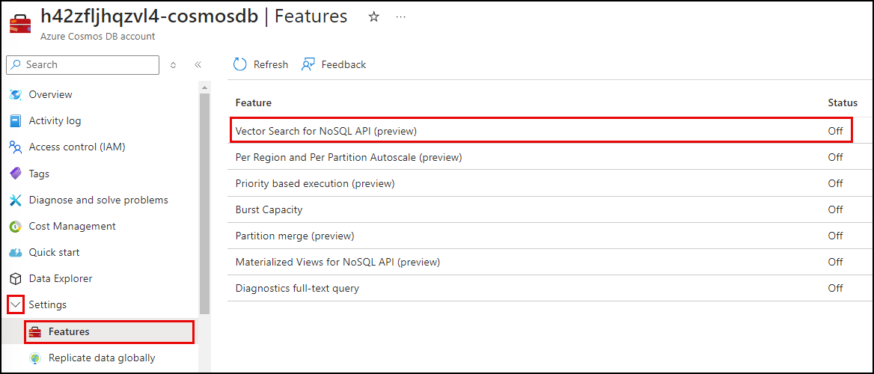
Vector Search for NoSQL API
You will enable the Vector Search for NoSQL API feature in Cosmos DB.
This feature is currently in public preview and may take 10+ minutes to finish enabling.
Notes:
Speaker notes:
Cosmos DB’s NoSQL API now has support for storing vector data. Enabling the feature itself may take upwards of 5-10 minutes. After that, you will need to wait another 5-10 minutes for background processes to complete before you can create a new container making use of this feature.
You cannot include vector storage on existing containers—you must define the container vector policy at container creation time.

Slide 29
Vector Distance
The VectorDistance() function calculates a similarity score between the vector stored in a record versus the vector of some incoming search term.
This is an example of a query using VectorDistance().
var query = $"SELECT c.hotel_id AS HotelId, c.hotel AS Hotel, c.details AS Details, c.source AS Source, VectorDistance(c.request_vector, [{string.Join(",", queryVector)}]) AS SimilarityScore FROM c";
query += $" WHERE VectorDistance(c.request_vector, [{string.Join(",", queryVector)}]) > {minimum_similarity_score}";
query += $" ORDER BY VectorDistance(c.request_vector, [{string.Join(",", queryVector)}])";
Notes:
Speaker notes:
Using the VectorDistance() function, we can compare a search term to records in our Cosmos DB container, without needing to move the data to another vector storage engine like Azure AI Search.

Slide 30
Implement audio transcription
Exercise 4

Slide 31
Introduction: Implement audio transcription
In this exercise, you’ll generate audio transcripts and learn how to vectorize and store their summaries in Cosmos DB.
After completing this lab, you’ll be able to:
Incorporate audio file upload and audio transcription into a Streamlit app
Check whether a call meets compliance requirements
Vectorize and save call transcripts and summaries into Cosmos DB
Perform vector search among call summaries and transcripts
Notes:
Speaker notes:
A common use case for call centers is interpreting and transcribing speech from telephone calls, as well as analyzing the contents of these calls. In a real-world scenario, customers may have hooks into their telephony systems that enable programmatic access to the live audio streams. In this exercise, you will use a simpler case: pre-recorded audio files that you can upload into the dashboard application and process.
Learning objectives
After completing this lab, you'll be able to:
Incorporate audio file upload and audio transcription into a Streamlit app
Check whether a call meets compliance requirements
Vectorize and save call transcripts and summaries into Cosmos DB
Perform vector search among call summaries and transcripts

Slide 32


Exercise 6 Architecture
Summarization
Extractive & Abstractive Summarization with Azure AI Language
Query-based Summarization
with Azure OpenAI
Azure AI
Language
Azure OpenAI
Cosmos DB
Named Entity Extraction
Sentiment Analysis & Opinion Mining
Azure AI
Language
Azure AI
Speech
Call transcription
Notes:
Speaker notes:
Exercise 4 focuses on audio transcription. You will transcribe a call center conversation. From there, you will use Azure AI Services and Azure OpenAI to generate summaries of a call transcript, using three different summarization methods (extractive, abstractive, and query-based), and then evaluate the output of each method. You will then use the Azure AI Language service to extract various insights from the call transcript, include assessing the sentiment of the call, performing opinion mining, and extracting named entities.
After that, you will store the transcript and its embedding in Cosmos DB, allowing you to perform vector search against transcript summaries.

Slide 33
Azure AI Services Speech Service
Provide speech-to-text and text-to-speech capabilities
Key scenarios
Captioning
Transcription
Speaker recognition
Creation of audio content
Create voice assistants
Notes:
Speaker notes:
The Azure AI Services Speech service provides two key capabilities. The first is translating speech to text, and the second is translating text to speech. Two common use cases for speech-to-text processing are captioning videos and creating transcripts of calls and meetings. We can also use speech-to-text to recognize speakers, improving the quality of transcripts when there are multiple people speaking. For the text-to-speech scenario, we can create audio content and even voice assistants using the service.
In this training, we will focus on the speech-to-text scenario.

Slide 34
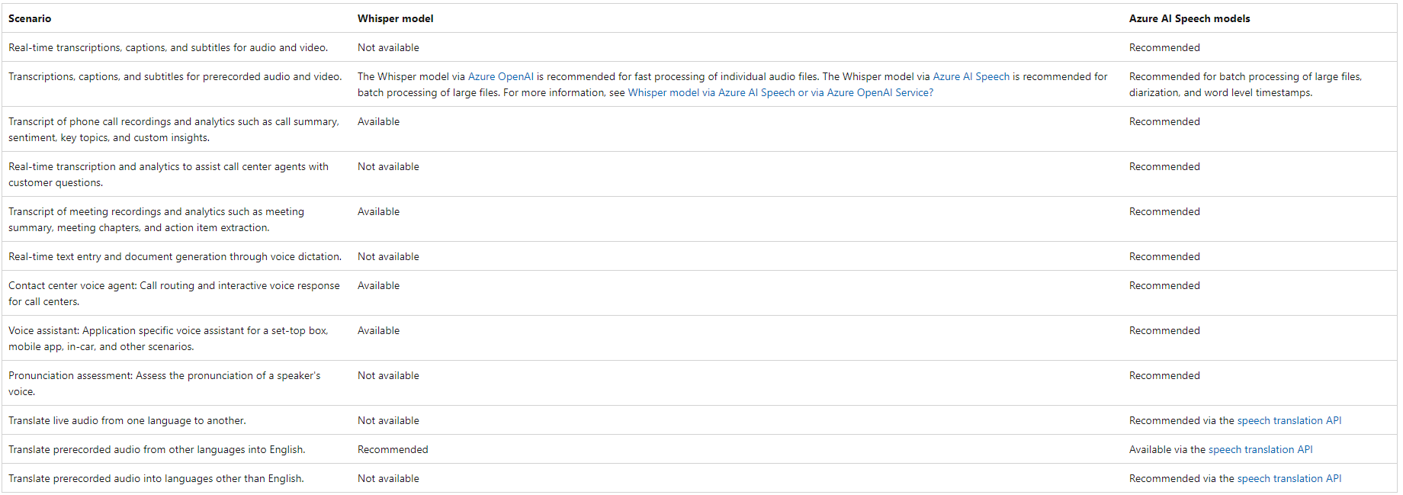
Whisper API vs AI Services Speech
Notes:
Speaker notes:
Azure OpenAI includes the Whisper API, which supports audio transcription. For that reason, knowledgeable users may ask, why use Azure AI Services here instead of sticking with Azure OpenAI? The reason is that the Whisper service has a separate intent from Azure AI Speech. Whisper’s primary use case is for processing audio files rather than real-time or live audio processing. For closer to real-time processing scenarios or the processing of large batch files, the Azure AI Speech service is typically a better choice.

Slide 35
Audio File Metadata
Each audio file has a few important attributes.
Audio file metadata attributes:
Number of channels
Bit depth
Sample rate (KHz)
Notes:
Speaker notes:
Each digital audio file has three attributes we care about: channels, bit depth, and sample rate.
The number of channels represents the number of recorded waveforms in our audio file. These channels allow us to simulate depth. We may, for example, use two channels in stereo sound: one channel for the speaker on the left and one for the speaker on the right.
The number of bits per sample is also known as the bit depth. It lets us track the amplitude of a waveform, and more bits per sample means a higher gradation in volume levels, but at the cost of larger files.
Finally, the sample rate is something we usually measure in kilohertz, where one hertz is one per second. A sample rate of 44.1 kilohertz and bit depth of 16 means we have 44,100 samples of 16 bits per second.
This is important because the Azure AI Services Speech service needs to know the proper values for channels, bit depth, and sample rate. If we send in incorrect values, we will end up with improper translations of audio files, as we will see in the exercise. Fortunately, it is easy to read file metadata to know what the proper values should be, so the likelihood of running into a problem in practice is low.

Slide 36
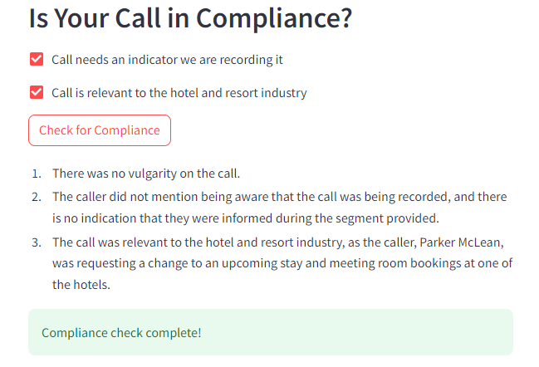
Call compliance
You will build a simple set of compliance checks for Contoso Suites.
In this procedure, you will create checks regarding:
Whether the call transcript contains vulgarity
Whether the call has an indicator that we are recording it for training or quality assurance purposes (optional)
Whether the call is relevant to Contoso Suites: if it is related to the hotel and resort industry (optional)
Notes:
Speaker notes:
You will implement a simple set of compliance checks for Contoso Suites. One of the three checks, whether the call transcript contains vulgarity, will be mandatory. The other two are optional. The first optional check is whether the call has an indicator that we are recording it for training or quality assurance purposes. This is usually a statement you may hear when calling a support line and it serves as affirmation that both parties accept that this call may be recorded. Depending upon the jurisdiction of the callers, this may be legally required in order to record a call.
The other optional check is whether the call is relevant to Contoso Suites inasmuch as it pertains to the hotel and resort industry.

Slide 37
Azure AI Language service
Named Entity Recognition (NER) and Custom Named Entity Recognition (Custom NER)
Personally identifying (PII) and health (PHI) information detection
Language detection
Sentiment analysis and opinion mining
Summarization
Key phrase extraction
Entity linking
Text analytics for health and Custom text analytics for health
Custom text classification
Conversational language understanding
Question answering
Notes:
Speaker notes:
The Azure AI Language is a cloud-based service that provides Natural Language Processing (NLP) features for understanding and analyzing text. The Language service brings together multiple capabilities, including:
Named Entity Recognition (NER) and Custom Named Entity Recognition (Custom NER): This feature is used to categorize entities (words or phrases) in unstructured text across predefined category groups, such as people, places, events, and dates.
Personally identifying (PII) and health (PHI) information detection: Identifies, categorizes, and redacts sensitive information from text. Examples include phone numbers, email addresses, and forms of identification.
Language detection: Detects the language in which a document is written.
Sentiment analysis and opinion mining: Helps you determine what people think of a topic by mining text for clues about positive or negative sentiment.
Summarization: Produces a summary of text.
Key phrase extraction: Evaluates and returns the main concepts in unstructured text.
Entity linking: Disambiguates the identity (words or phrases) found in text and returns links to Wikipedia.
Text analytics for health and Custom text analytics for health: Extracts and labels relevant medical information from text, such as doctor’s notes, clinical documents, and electronic health records.
Custom text classification: Enables you to build custom AI models to classify unstructured text documents into classes you define.
Conversational language understanding: Enables you to build custom natural language understanding models.
Question answering: Finds the most appropriate answer for inputs from users.
In this lab, we will focus on Summarization, Sentiment analysis and opinion mining, and Named Entity Recognition (NER).

Slide 38
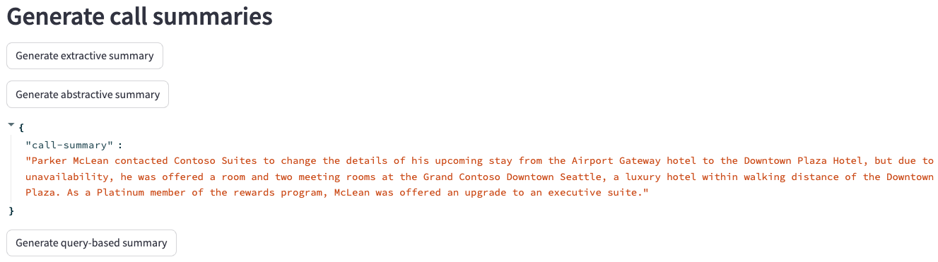
Call Summarization
Using Azure AI Language service and Azure OpenAI, you will use three different techniques for generating summaries of a call transcript.
Extractive
Abstractive
Query-based
Notes:
Speaker notes:
Summarization is a technique in which AI is leveraged to produce a summary of a document or conversation transcription. Text summarization is designed to shorten content that users consider too long to read. AI-based summarization focuses on highlighting the most important aspects of the text. Azure AI Services provide several mechanism for summarizing text. There are three primary techniques used for performing summarization:
The Language service provides the first two methods, extractive and abstractive summarization functions, both of which condense text or documents into key sentences.
- Extractive summarization: Extractive summarization is a method in which the AI evaluates text to ascertain the key concepts and ideas it represents. A summary is created by extracting the sentences that collectively represent the most important or relevant information within the original content.
- Abstractive summarization: Abstractive summarization follows a similar pattern of using AI to evaluate the most important information with the original content but differs in that it produces a summary by generating new, original sentences from the document that capture the main idea.
Azure OpenAI provides the third summarization method:
- Query-based summarization: Query-based summarization leverages generative AI and large language models (LLMs), such as gpt-4.0 provided by Azure OpenAI, to create a summary based on the key ideas within text. For query-based summarization, you will provide the LLM with the natural language instructions it requires to identify the task you want it to perform, using a process known as prompt engineering.

Slide 39
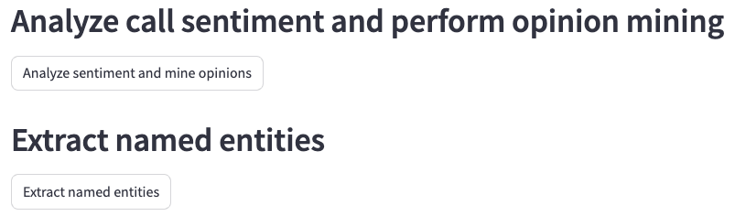
Extract insights
You will use features of Azure AI Language to extract insights from a call transcript.
In this task, you will extract insights using the Azure AI Language service:
Analyze sentiment of the call
Mine opinions
Extract named entities
Notes:
Speaker notes:
Azure AI Language is a cloud-based service that provides Natural Language Processing (NLP) features for understanding and analyzing text. In the last task, you used the Azure AI Language service for text summarization. You will take the analysis at step further in this task, extracting named entities and performing sentiment analysis and opinion mining over the same call transcript.
- Sentiment analysis and opinion mining are features that help you assess what people think of your brand or topic by mining text for clues about positive or negative sentiment and can associate them with specific aspects of the text.
- Named entity recognition (NER) categorizes entities (words or phrases) in unstructured text across several predefined category groups. For example: people, events, places, and dates.
In this task, you will leverage your Azure AI Language service to extract insights from a call transcript. You will start by analyzing the sentiment of the transcript and performing opinion mining against the text. You will then extract named entities from the transcript.

Slide 40
Enhance the API with Semantic Kernel Orchestration
Exercise 5

Slide 41
Introduction: Enhance the API with Semantic Kernel Orchestration
In this lab, you will enable users to upload audio files or stream input from their microphone. The audio will go through the AI Services Speech service, which will transform that audio to text. You will also implement a simple form of compliance checking on the audio to ensure it meets policy requirements for Contoso Suites.
After completing this lab, you’ll be able to:
Implement Semantic Kernel orchestration in a .NET API
Create an agent using Semantic Kernel
Assign skills to an agent
Use built-in AI services from Semantic Kernel in your applications
Notes:
Speaker notes:
Semantic Kernel is an open-source SDK that lets you easily build agents that can call your existing code. You have already assisted Contoso Suites with incorporating Semantic Kernel into their existing API infrastructure.
In this exercise, you will expand on the work you did with Semantic Kernel in Exercise 02 and dive into the LLM orchestration capabilities it provides. By combining Contoso Suites’ existing C# and Python code with Semantic Kernel, you will build agents that answer questions and automate processes. You will also use prompt filtering and explore some prompt engineering techniques.
Learning objectives
After completing this lab, you'll be able to:
I mplement Semantic Kernel orchestration in a .NET API
Create an agent using Semantic Kernel
Assign skills to an agent
Use built-in AI services from Semantic Kernel in your applications

Slide 42
Exercise 5 Architecture
Azure OpenAI
Cosmos DB
SQL DB
Semantic Kernel integration point
Web API (C#)
Notes:
This exercise will focus on extending the existing .NET API’s Semantic Kernel capabilities, creating a copilot for Contoso Suites that supports call center agents as they search for and save maintenance requests.

Slide 43
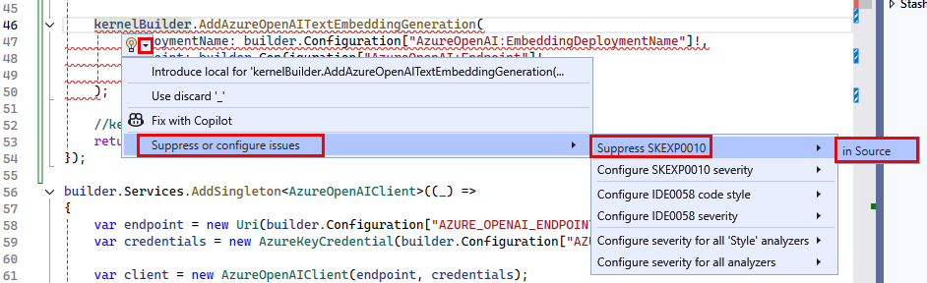
Suppressing Issues
You will need to suppress SKEXP0010 and SKEXP0001 during this exercise.
As Semantic Kernel matures further, these suppression statements will become unnecessary.
Notes:
Speaker notes:
As of September, 2024, the AddAzureOpenAITextEmbeddingGeneration feature of Semantic Kernel is flagged for evaluation purposes only, so, you must suppress that issue to be able to use it in the project. The same is true for the GenerateEmbeddingAsync() method call.

Slide 44
Creating an Agent
Agents are leverage AI models to perform work. You can provide agents with a persona or “meta prompt” to influence how it responds to inputs.
This is an example of a meta prompt we can use to specify agent behavior.
"""
You are a friendly assistant who likes to follow the rules. You will complete required steps and request approval before taking any consequential actions, such as saving the request to the database.
If the user doesn't provide enough information for you to complete a task, you will keep asking questions until you have enough information to complete the task. Once the request has been saved to the database, inform the user that hotel maintenance has been notified and will address the issue as soon as possible.
"""
Notes:
Speaker notes:
Agents are software based entities that leverage AI models to perform work. They are built to perform a wide range of tasks and called different names, such as chatbot or copilot, based on the jobs they do. You can provide agents with a persona or “meta prompt” to influence how it responds to inputs, allowing you to direct how your agent plans tasks, generates responses, and interacts with users.

Slide 45
Add GenAI Gateway Capabilities with Azure API Management
Exercise 6

Slide 46

Introduction: Add GenAI Gateway Capabilities with Azure API Management
In this exercise, you will import your Azure OpenAI service as an API in APIM and enable the generative AI (GenAI) gateway capabilities.
After completing this exercise, you’ll be able to:
Import an Azure OpenAI Service resource as an API in Azure API Management
Use APIM policies to manage token consumption and monitor token usage
Integrate APIM-managed APIs into GenAI applications
Load balance LLM workloads across two Azure OpenAI service instances (Optional)
Notes:
Speaker notes:
Azure API Management (APIM) provides a range of policies, metrics, and other features to enhance security, performance, and reliability for APIs serving your intelligent apps. Collectively, these features are called generative AI (GenAI) gateway capabilities.
In this exercise, you will import your Azure OpenAI service as an API in APIM and enable the generative AI (GenAI) gateway capabilities.
Learning objectives
Upon completion of this lab, you will have gained the following skills:
Import an Azure OpenAI Service resource as an API in Azure API Management
Use APIM policies to manage token consumption and monitor token usage
Integrate APIM-managed APIs into GenAI applications
Load balance LLM workloads across two Azure OpenAI service instances (Optional)

Slide 47
Exercise 6 Architecture
Cosmos DB
SQL DB
Primary
Azure OpenAI
UI (Python)
Web API (C#)
API Management
Secondary
Azure OpenAI
Notes:
Azure API Management (APIM) provides a range of policies, metrics, and other features to enhance security, performance, and reliability for APIs serving your intelligent apps. Collectively, these features are called generative AI (GenAI) gateway capabilities.
This exercise focuses on incorporating the generative AI (GenAI) gateway capabilities of Azure API Management into the Contoso applications.

Slide 48
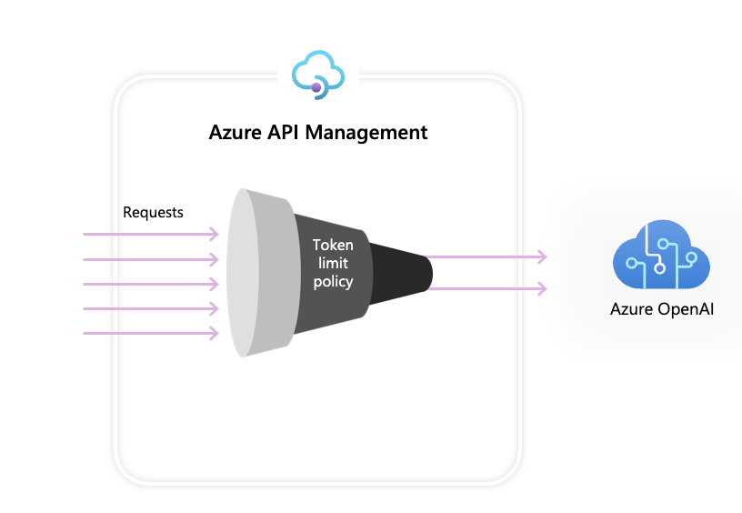
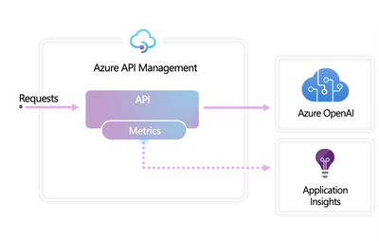
Manage token consumption
APIM’s GenAI Gateway capabilities provide token consumption management functionality
Token limit policy
Emit token metric policy
Notes:
Speaker notes:
Azure OpenAI Token Limit policy
The Azure OpenAI Token Limit policy allows you to manage and enforce limits per API consumer based on the usage of Azure OpenAI tokens. With this policy, you can set limits expressed in tokens per minute (TPM).
This policy provides flexibility in assigning token-based limits on any counter key, such as subscription key, IP address, or any other arbitrary key defined through policy expression.
The policy also enables pre-calculation of prompt tokens on the Azure API Management side, minimizing unnecessary requests to the Azure OpenAI backend if the prompt already exceeds the limit.
Azure OpenAI Emit Token Metric policy
Azure OpenAI enables you to configure token usage metrics to be sent to Azure Applications Insights, which provides an overview of the utilization of Azure OpenAI models across multiple applications or API consumers.
This policy captures prompt, completions, and total token usage metrics and sends them to Application Insights namespace of your choice.
Moreover, you can configure or select from pre-defined dimensions to split token usage metrics, enabling granular analysis by Subscription ID, IP Address, or any custom dimension you choose.

Slide 49
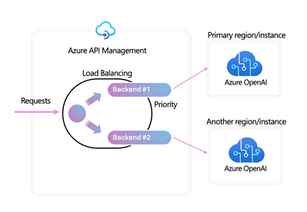
Balance LLM load across multiple Azure OpenAI instances
The APIM Load Balancer feature spreads LLM workloads across multiple Azure OpenAI endpoints
Notes:
Speaker notes:
With support for round-robin, weighted, and priority-based load balancing, you can now define your own load distribution strategy according to your specific requirements.
You can define priorities within the load balancer configuration to ensure optimal utilization of specific Azure OpenAI endpoints, particularly those purchased as PTUs.
In the event of any disruption, a circuit breaker mechanism kicks in, seamlessly transitioning to lower-priority instances based on predefined rules.
The circuit breaker capability features dynamic trip duration, leveraging values from the retry-after header provided by the backend, ensuring precise and timely recovery of the backends and maximizing the utilization of your priority backends to their fullest.

Slide 50
Workshop Resource Cleanup
Exercise 7

Slide 51


Introduction: Workshop Resource Cleanup
In this exercise, you will delete the Azure and GitHub codespaces resources you created for this workshop.
After completing this exercise, you will have deleted all workshop-related resources.
Delete your GitHub codespaces instance
Delete all Azure resources
Notes:
Speaker notes:
This exercise is simply to ensure participants delete all resources they created for this workshop, whether they were manually created or provisioned via Bicep scripts.
Learning objectives
After completing this lab, you will have deleted all resources created for this workshop.
Delete GitHub codespaces
Delete Azure resource group and all resources within it
If you completed the bonus activity in Exercise 6 Task 2 for load balancing, delete the resource group and secondary Azure OpenAI instance.

